Slide 1
Participatory Traffic Control with Connected and Automated Vehicles for Network Efficiency
TRISTAN XII, Okinawa, Japan, June 22, 2025
Yafeng Yin, Ph.D.
Donald Cleveland Collegiate Professor of Engineering
Donald Malloure Department Chair of Civil and Environmental Engineering
University of Michigan, Ann Arbor

Slide 2
Contributors
Minghui Wu, Richard Lee, Xi Lin, and Jeff Scruggs, University of Michigan, Ann Arbor
Zhibin Chen, New York University Shanghai
Jerry Lynch, Duke University
Meng Li, Tsinghua University

Slide 3
1 Participatory Traffic Control 2 CAVs as Demand Distributors 3 Recruiting CAVs for Participation 4 Controlling CAVs for Network Efficiency 5 Concluding Remarks

Slide 4
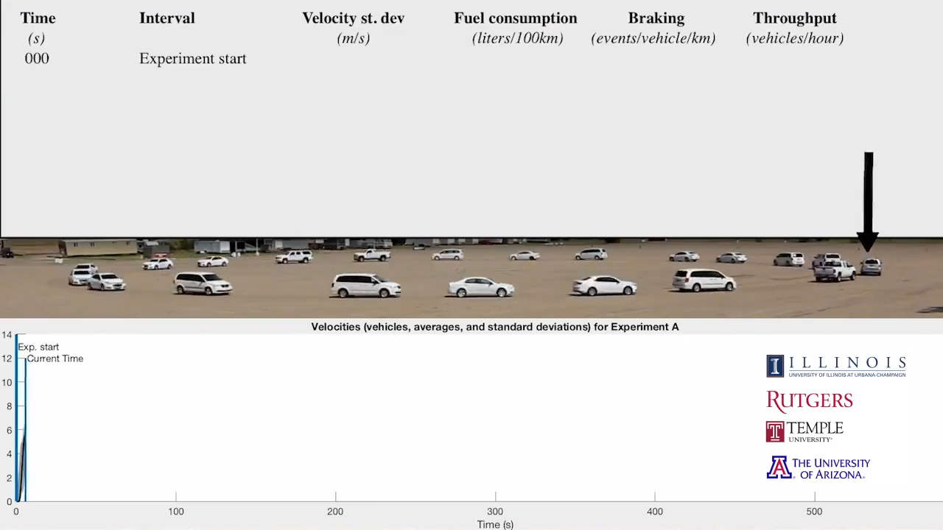
Participatory Traffic Control
Utilizing connected and automated vehicles (CAVs) within the traffic stream as control actuators to manage traffic
CAVs as traffic stream regulator
Wu et al. (2018), Stern et al. (2018) and Jin et al. (2018)
“Flow control will be possible via a few mobile actuators (less than 5%)” (Stern et al., 2018)
Source: https://flow-project.github.io/

Slide 5
Leveraging Relinquished Human Agency in Travel
Human agency is the capacity for individuals to act independently and make their own decisions based on personal volition.
This concept is highly relevant to travel, encompassing multiple facets such as the timing of travel, choice of destination, mode, and route, driving tasks, and adaptability.
While traditionally personal vehicles have been marketed with cultural symbols of security, freedom, and control, the advent of driving automation requires travelers to increasingly surrender aspects of their agency.

Slide 6
Leveraging Relinquished Human Agency
Human agency
Enabled control
Incentivized to relinquish
Mode
Active travel demand management
Destination
CAVs as traffic demand distributors
Departure time
Participatory Traffic Control
Route
CAVs as traffic stream regulators
Driving maneuvers

Slide 7
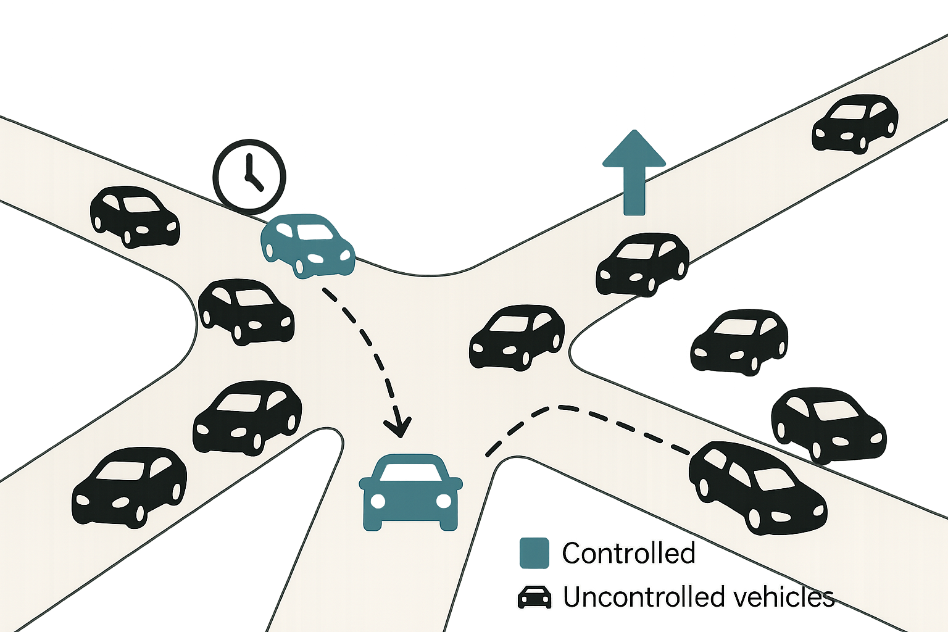
CAVs as Traffic Demand Distributors
The working hypothesis is that, by controlling the departure time or route choice of a small number of CAVs, we can influence a larger number of uncontrolled vehicles’ travel decisions to improve the overall system performance.
What percentage of traffic do we need to control?
Let’s examine the minimum percentage of traffic that needs to be controlled to replicate system optimum in a traffic network

Slide 8
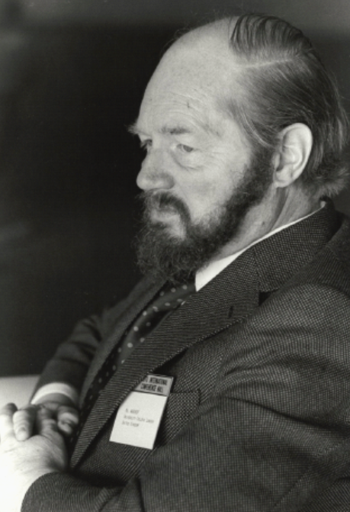
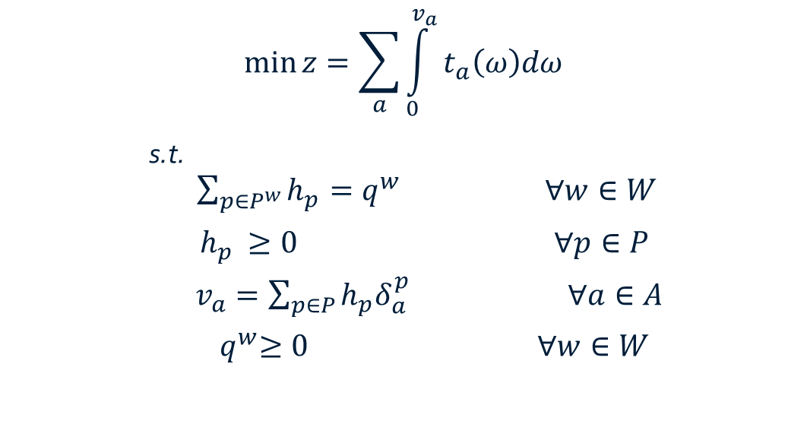
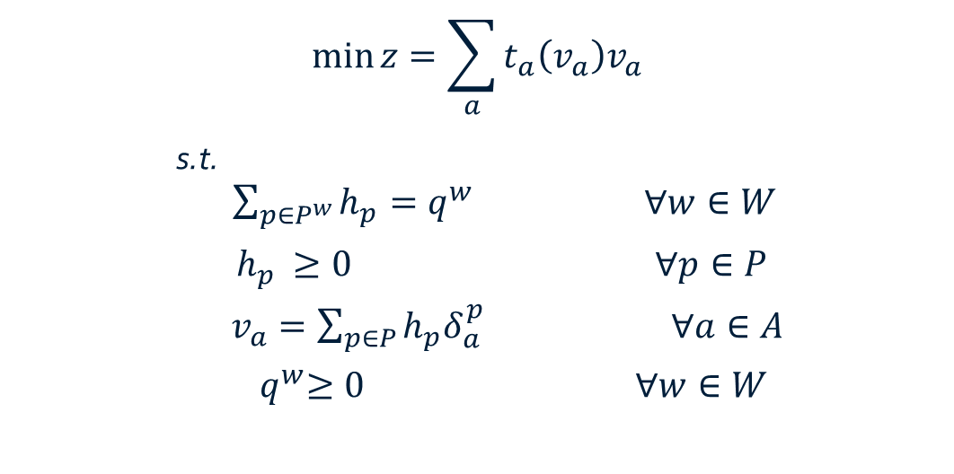
Wardrop's Principles of Traffic Assignment*
Feature | First Principle (User Equilibrium) | Second Principle (System Optimum)
Behavior Type | Selfish (user optimal) | Altruistic or centrally controlled
Stability | Nash Equilibrium | Requires control to be stable
Realism | More realistic for decentralized systems | Ideal goal for planning or control
Total System Cost | Higher than or equal to SO | Minimal possible total travel time
Formulation
John Wardrop
(1922–1989)
* Wardrop J. (1952) Some Theoretical Aspects of Road Traffic Research. Proceedings, Institution of Civil Engineers II(1), pp. 325-378.

Slide 9
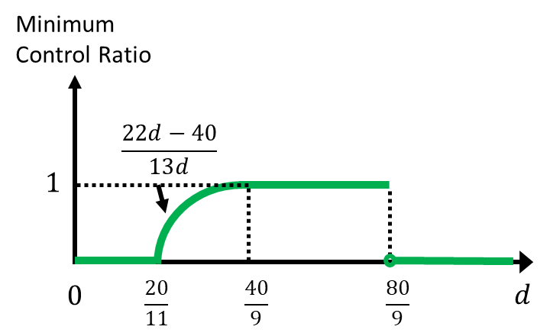
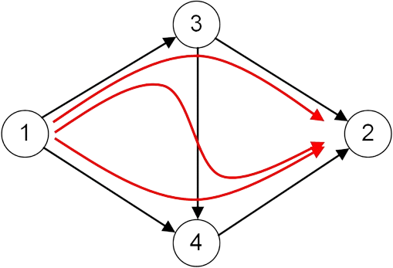
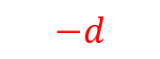
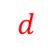
Controlling CAVs to Replicate System Optimum
What is the minimum percentage of traffic that needs to be controlled?
Cooperative AVs (CAVs): System optimum routing principle
Uncontrolled Vehicles (UVs): User optimal routing principle
$$d$$
$$−d$$
Braess network

Slide 10
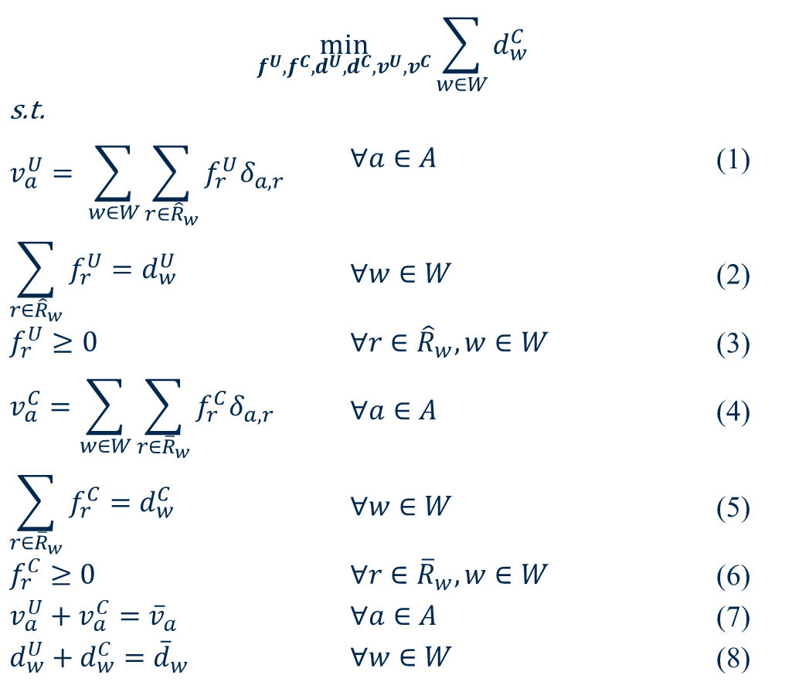
Minimum Control Ratio (MCR) Formulation
$$\min_{f^{U}, f^{C}, d^{U}, d^{C}, v^{U}, v^{C}}{\sum_{w∈W}{d_{w}^{C}}}$$
s.t. $$v_{a}^{U}= \sum_{w∈W}{\sum_{r∈{\hat{R}}_{w}}{f_{r}^{U}δ_{a,r}}}$$ | $$∀a∈A$$ | (1)
$$\sum_{r∈{\hat{R}}_{w}}{f_{r}^{U}=d_{w}^{U}}$$ | $$∀w∈W$$ | (2)
$$f_{r}^{U}≥0$$ | $$∀r∈{\hat{R}}_{w}, w∈W$$ | (3)
$$v_{a}^{C}=\sum_{w∈W}{\sum_{r∈{\overline{R}}_{w}}{f_{r}^{C}δ_{a,r}}}$$ | $$∀a∈A$$ | (4)
$$\sum_{r∈{\overline{R}}_{w}}{f_{r}^{C}=d_{w}^{C}}$$ | $$∀w∈W$$ | (5)
$$f_{r}^{C}≥0$$ | $$∀r∈{\overline{R}}_{w}, w∈W$$ | (6)
$$v_{a}^{U}+v_{a}^{C}={\overline{v}}_{a}$$ | $$∀a∈A$$ | (7)
$$d_{w}^{U}+d_{w}^{C}={\overline{d}}_{w}$$ | $$∀w∈W$$ | (8)
Set of paths with minimum travel time
Set of paths with minimum marginal travel time

Slide 11
MCR in Real-World Networks*
Network | Zones | Nodes | Links | MCR (%)
Anaheim | 38 | 416 | 914 | 21
Barcelona | 110 | 1020 | 2522 | 36
Berlin-Mitte-Prenzlauer Berg-Friedrichshain-Center | 98 | 975 | 2184 | 14
Eastern-Massachusetts | 74 | 74 | 258 | 20
Sioux Falls | 24 | 24 | 76 | 14
Terrassa | 55 | 1609 | 3264 | 57
Winnipeg | 147 | 1052 | 2836 | 42
*Chen, Z., Lin, X, Yin, Y. and Li, M. (2020) Path controlling of automated vehicles for system optimum on transportation networks with heterogeneous traffic stream. Transportation Research Part C: Emerging Technologies, 110, 312-329.
Notes:
25%...

Slide 12
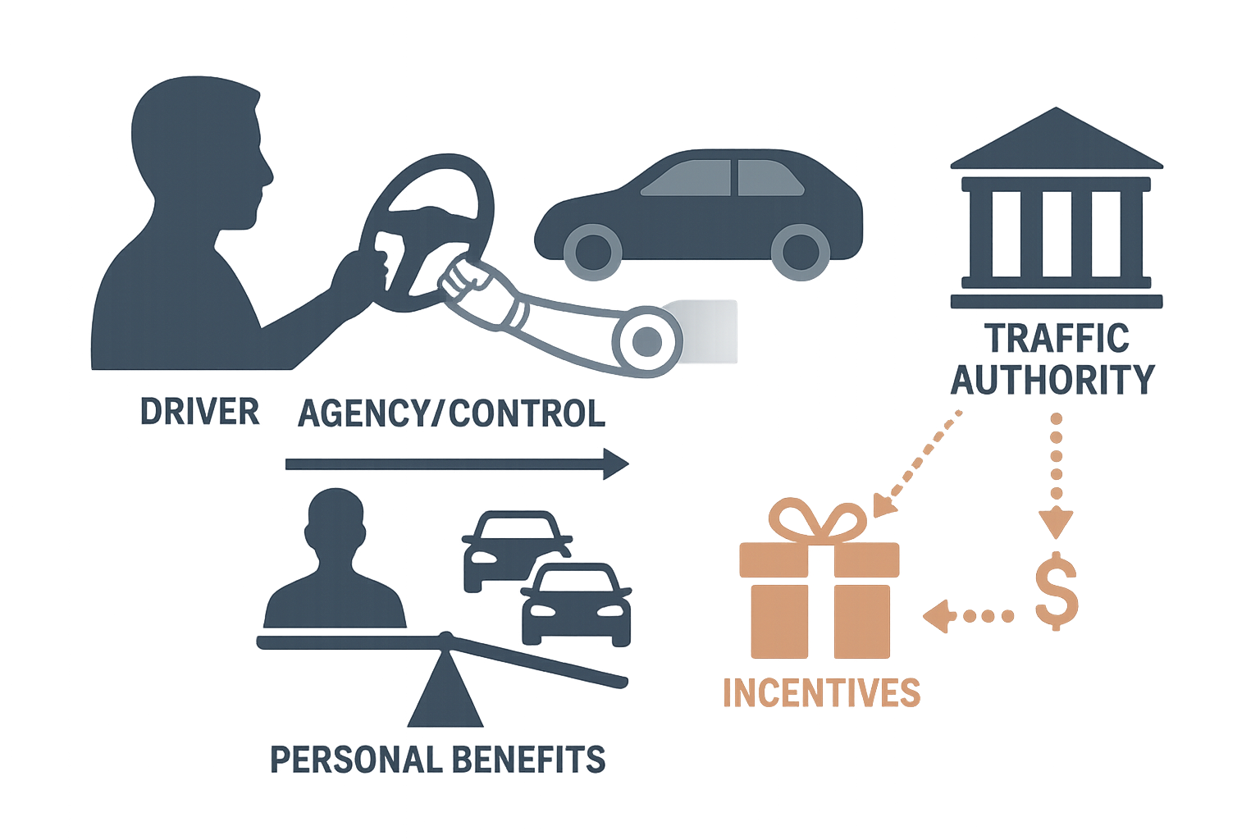
Recruiting CAVs for Participation
Drivers delegating control to machines does not necessarily mean they are willing to sacrifice personal benefits for system-level improvements.
Incentives may be necessary to encourage CAV participation in traffic control schemes. These incentives should compensate drivers for their loss of agency and potential increases in travel costs.
So, how can we design effective incentive schemes to recruit CAVs for implementing participatory traffic control?

Slide 13
Recruiting CAVs for Participation

Slide 14
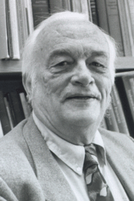

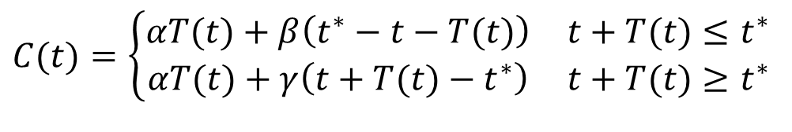

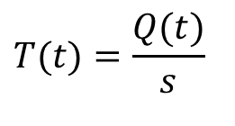
Morning Commute Setting (Vickrey, 1969)
Work starting time (9:30)
N persons
Capacity = s
William Vickrey
(1914-1996;
Nobel Laureate, 1996 )
Early/Late Arrival Penalty
$$C(t)=\left\{\begin{matrix}αT(t)+β\left(t^{∗}−t−T(t)\right) & t+T(t)≤t^{∗} \\ αT(t)+γ\left(t+T(t)−t^{∗}\right) & t+T(t)≥t^{∗}\end{matrix}\right.$$
$$γ>α>β$$
$$T(t)=\frac{Q(t)}{s}$$
Arrival Time

Slide 15
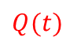
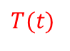
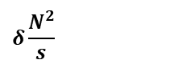
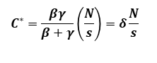
Equilibrium Departure Time Choice
Travel Cost
Total travel cost =
$$δ\frac{N^{2}}{s}$$
$$C^{∗}=\frac{βγ}{β+γ}\left(\frac{N}{s}\right)=δ\frac{N}{s}$$
Arrival Time
# of vehicles
Cumulative arrivals at bottleneck
$$Q(t)$$
$$T(t)$$
Cumulative departures at bottleneck
Time
Queueing Diagram at Bottleneck

Slide 16
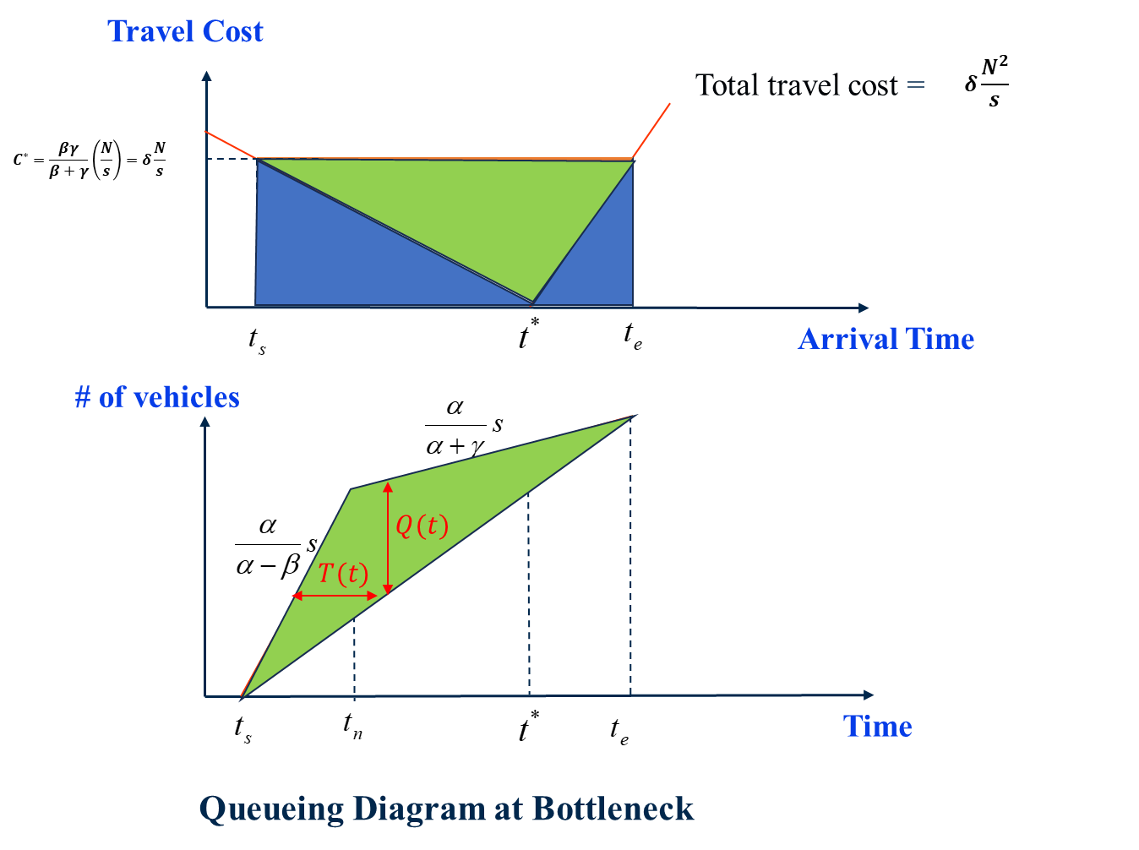
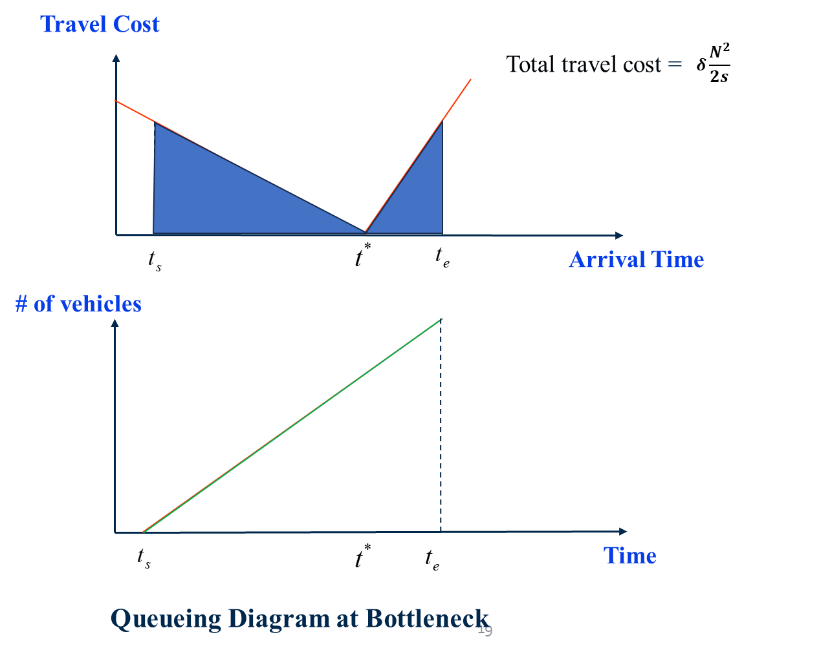
Equilibrium vs Optimum
Equilibrium
Optimum

Slide 17
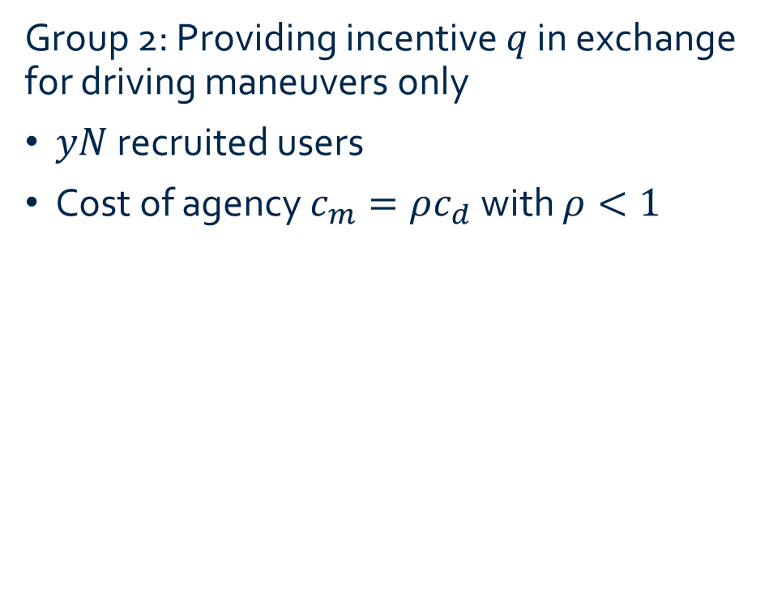
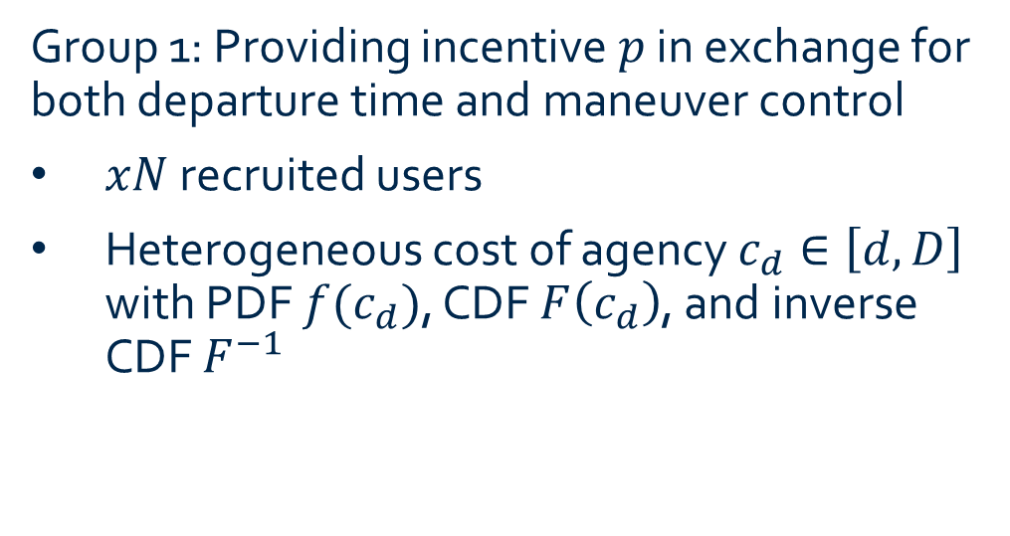
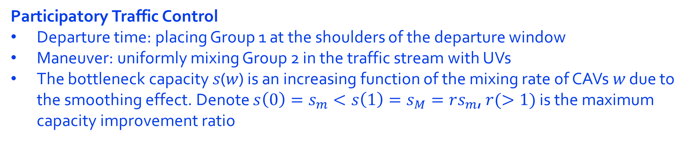
Recruiting CAVs for Participatory Traffic Control
Group 1: Providing incentive $p$ in exchange for both departure time and maneuver control
$xN$ recruited users
Heterogeneous cost of agency $c_{d}∈\left[d,D\right]$ with PDF $f(c_{d})$, CDF $F\left(c_{d}\right)$, and inverse CDF $F^{−1}$
Group 2: Providing incentive $q$ in exchange for driving maneuvers only
$yN$ recruited users
Cost of agency $c_{m}=ρc_{d}$ with $ρ<1$
Participatory Traffic Control
Departure time: placing Group 1 at the shoulders of the departure window
Maneuver: uniformly mixing Group 2 in the traffic stream with UVs
The bottleneck capacity 𝑠(𝑤) is an increasing function of the mixing rate of CAVs 𝑤 due to the smoothing effect. Denote $s\left(0\right)=s_{m}<s\left(1\right)=s_{M}=rs_{m}$, $r(>1)$ is the maximum capacity improvement ratio

Slide 18
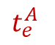

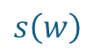
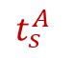

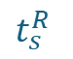
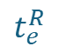


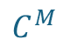

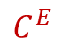

Equilibrium Solutions under Control
$xN$ Group 1 CAVs
Cumulative departures/ arrivals
$$s_{M}$$
$$s\left(w\right)$$
$$s_{M}$$
$$t_{s}^{A}$$
$$t_{e}^{A}$$
Time
Average travel cost of Group 1 recruits
Travel cost
Equilibrium travel cost of remaining commuters
$$C_{E}=δN\left(\frac{1−x}{s\left(w\right)}+\frac{x}{2s_{M}}\right)$$
$$C_{M}=δ\frac{N(1−x)}{s\left(w\right)}$$
$$C^{E}$$
$$C^{M}$$
Time
$$t_{s}^{R}$$
$$t_{e}^{R}$$
$yN$ Group 2 CAVs

Slide 19
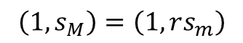
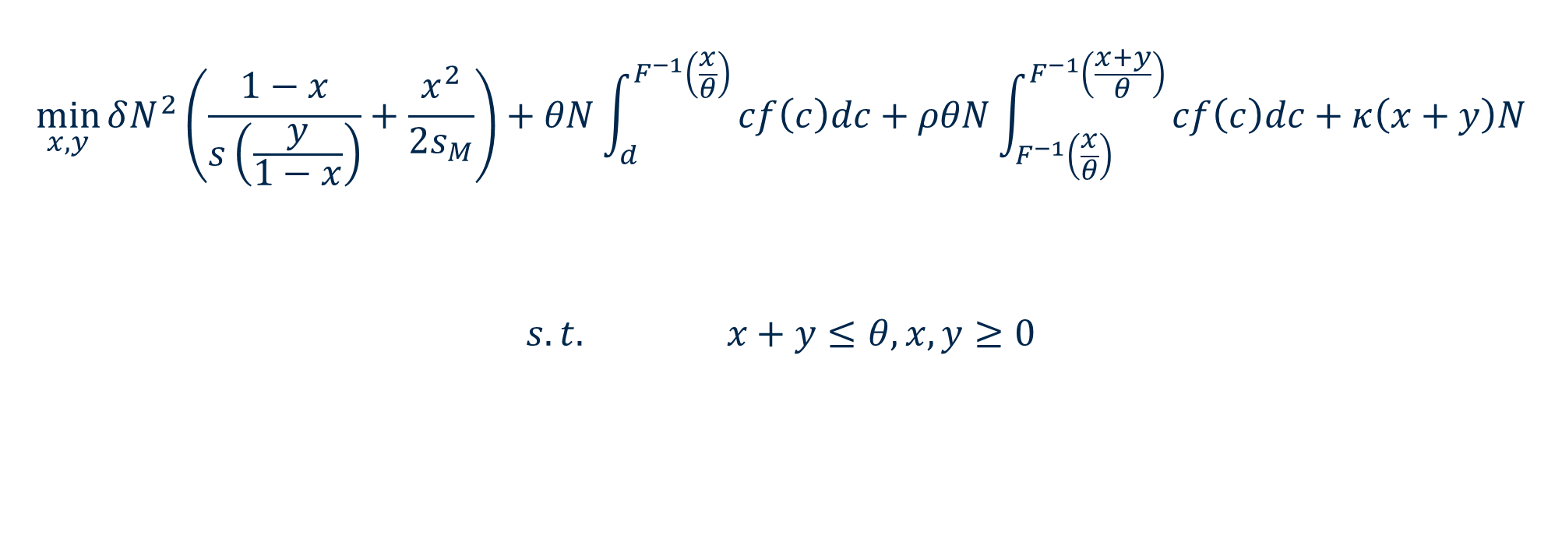

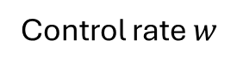
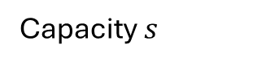
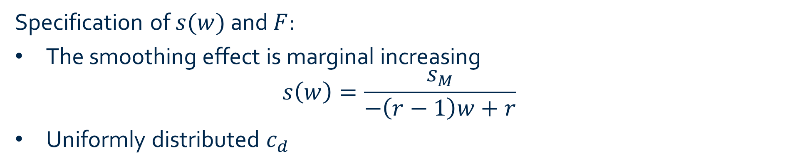
First-Best Design
$$\min_{x,y}{δN^{2}\left(\frac{1−x}{s\left(\frac{y}{1−x}\right)}+\frac{x^{2}}{2s_{M}}\right)+θN\int_{d}^{F^{−1}\left(\frac{x}{θ}\right)}{cf\left(c\right)dc}+ρθN\int_{F^{−1}\left(\frac{x}{θ}\right)}^{F^{−1}\left(\frac{x+y}{θ}\right)}{cf\left(c\right)dc}+κ\left(x+y\right)N}$$
$$s.t. x+y≤θ,x,y≥0$$
Total travel cost
Total cost of agency
Operation cost
Capacity $s$
Specification of $s(w)$ and $F$:
The smoothing effect is marginal increasing
$$s\left(w\right)=\frac{s_{M}}{−\left(r−1\right)w+r}$$
Uniformly distributed $c_{d}$
$$\left(1,s_{M}\right)=\left(1,rs_{m}\right)$$
$$\left(0,s_{m}\right)$$
Control rate $w$

Slide 20
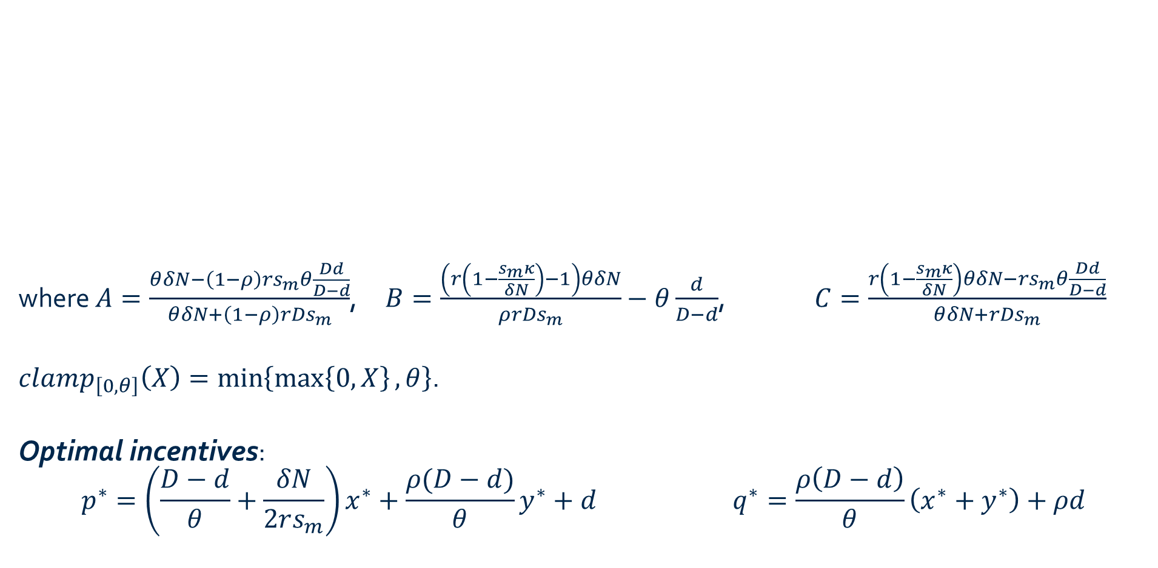
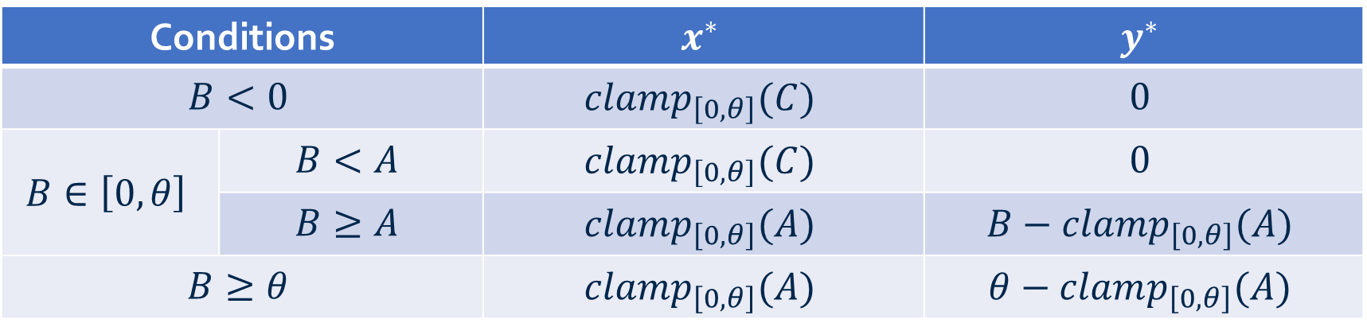
Analytical Solutions
Conditions |  | $$x^{∗}$$ | $$y^{∗}$$
$$B<0$$ |  | $$clamp_{\left[0,θ\right]}(C)$$ | $$0$$
$$B∈\left[0,θ\right]$$ | $$B<A$$ | $$clamp_{\left[0,θ\right]}(C)$$ | $$0$$
 | $$B≥A$$ | $$clamp_{\left[0,θ\right]}(A)$$ | $$B−clamp_{\left[0,θ\right]}(A)$$
$$B≥θ$$ |  | $$clamp_{\left[0,θ\right]}(A)$$ | $$θ−clamp_{\left[0,θ\right]}(A)$$
where $A=\frac{θδN−\left(1−ρ\right)rs_{m}θ\frac{Dd}{D−d}}{θδN+\left(1−ρ\right)rDs_{m}}$, $B=\frac{\left(r\left(1−\frac{s_{m}κ}{δN}\right)−1\right)θδN}{ρrDs_{m}}−θ\frac{d}{D−d}$, $C=\frac{r\left(1−\frac{s_{m}κ}{δN}\right)θδN−rs_{m}θ\frac{Dd}{D−d}}{θδN+rDs_{m}}$
$clamp_{\left[0,θ\right]}\left(X\right)=\min\left\{\max\left\{0,X\right\},θ\right\}$.
Optimal incentives:
$$p^{∗}=\left(\frac{D−d}{θ}+\frac{δN}{2rs_{m}}\right)x^{∗}+\frac{ρ(D−d)}{θ}y^{∗}+d q^{∗}=\frac{ρ\left(D−d\right)}{θ}\left(x^{∗}+y^{∗}\right)+ρd$$
Unconstrained recruitment target for Group 1
Adjusted recruitment target for Group 1 with Group 2 not being activated
Unconstrained total recruitment target

Slide 21
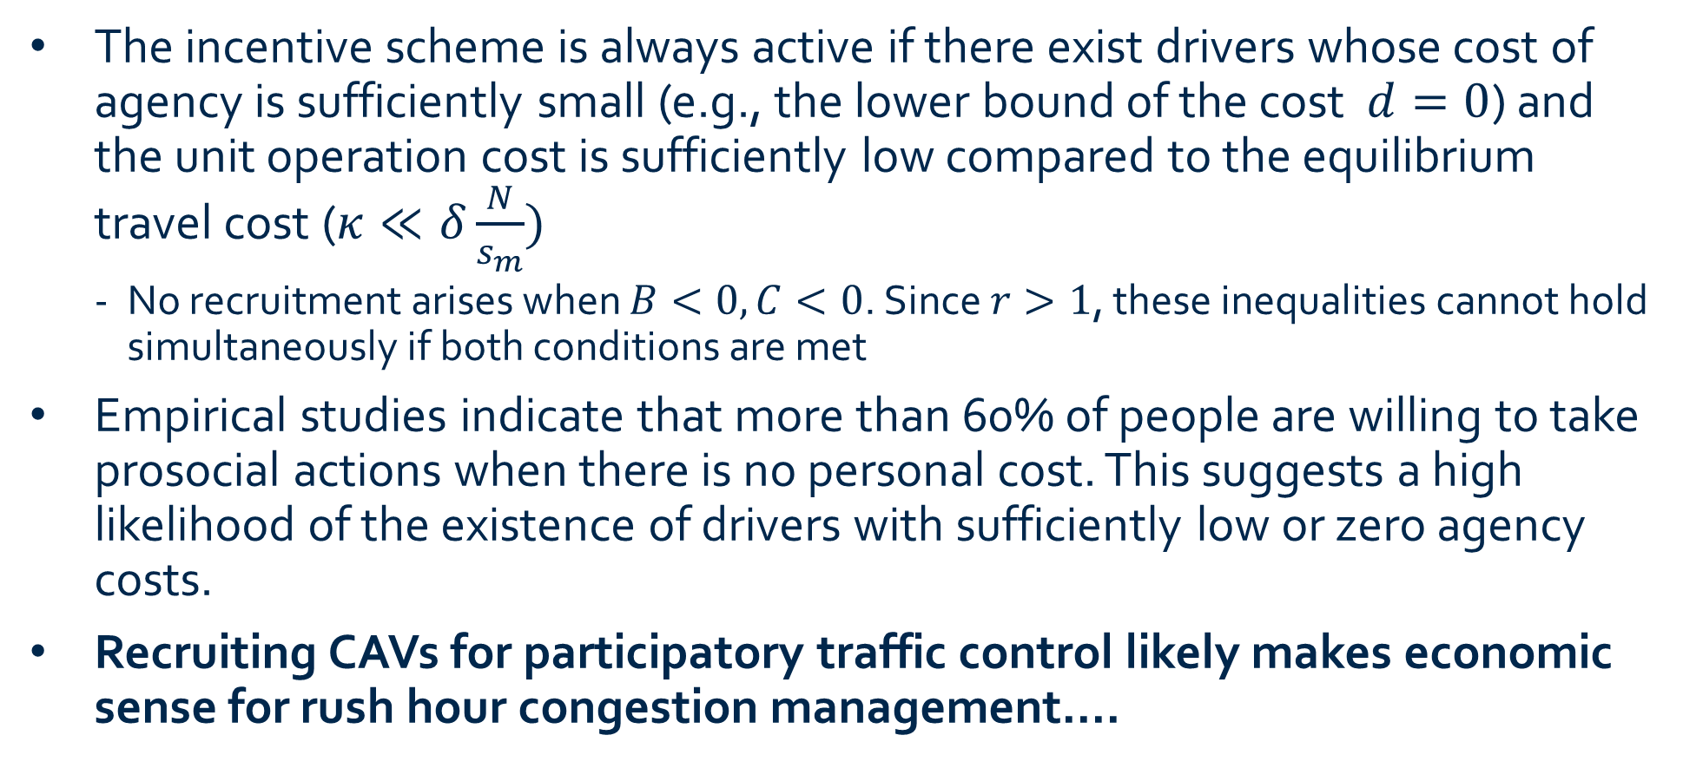
Managerial Insights – Economic Feasibility
The incentive scheme is always active if there exist drivers whose cost of agency is sufficiently small (e.g., the lower bound of the cost $d=0$) and the unit operation cost is sufficiently low compared to the equilibrium travel cost ($κ≪δ\frac{N}{s_{m}})$
No recruitment arises when $B<0, C<0$. Since $r>1$, these inequalities cannot hold simultaneously if both conditions are met
Empirical studies indicate that more than 60% of people are willing to take prosocial actions when there is no personal cost. This suggests a high likelihood of the existence of drivers with sufficiently low or zero agency costs.
Recruiting CAVs for participatory traffic control likely makes economic sense for rush hour congestion management.…

Slide 22

Managerial Insights – Economic Feasibility
…. especially in large cities!
The number of recruits increases as N increases
In high-demand scenarios, travel cost dominates, and participatory control offers greater leverage to reduce the total cost
$$B=\frac{\left(r\left(1−\frac{s_{m}κ}{δN}\right)−1\right)θδN}{ρrDs_{m}}−θ\frac{d}{D−d}$$
$$\min_{x,y}{δN^{2}\left(\frac{1−x}{s\left(\frac{y}{1−x}\right)}+\frac{x^{2}}{2s_{M}}\right)+θN\int_{d}^{F^{−1}\left(\frac{x}{θ}\right)}{cf\left(c\right)dc}+ρθN\int_{F^{−1}\left(\frac{x}{θ}\right)}^{F^{−1}\left(\frac{x+y}{θ}\right)}{cf\left(c\right)dc}+κ\left(x+y\right)N}$$
Total travel cost
Total cost of agency
Operation cost

Slide 23
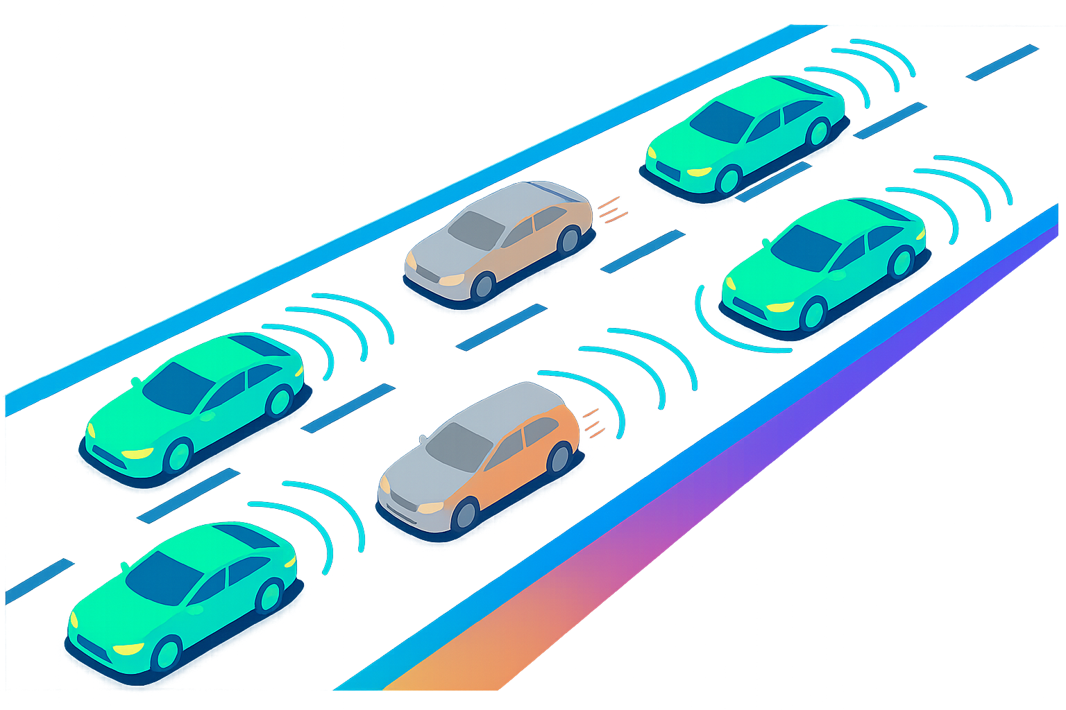
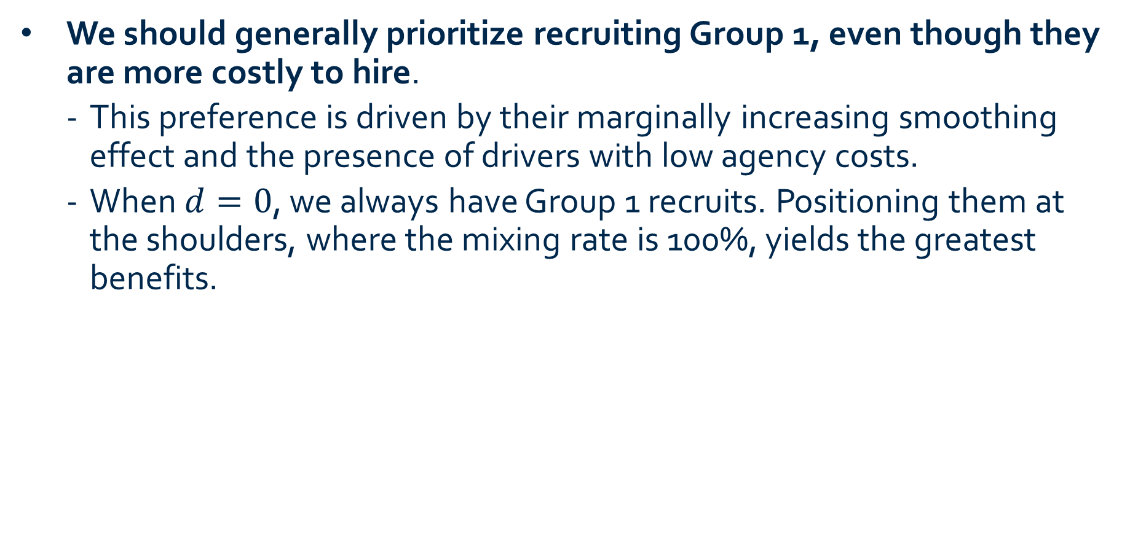
Managerial Insights – Hiring Strategy
We should generally prioritize recruiting Group 1, even though they are more costly to hire.
This preference is driven by their marginally increasing smoothing effect and the presence of drivers with low agency costs.
When $d=0$, we always have Group 1 recruits. Positioning them at the shoulders, where the mixing rate is 100%, yields the greatest benefits.

Slide 24

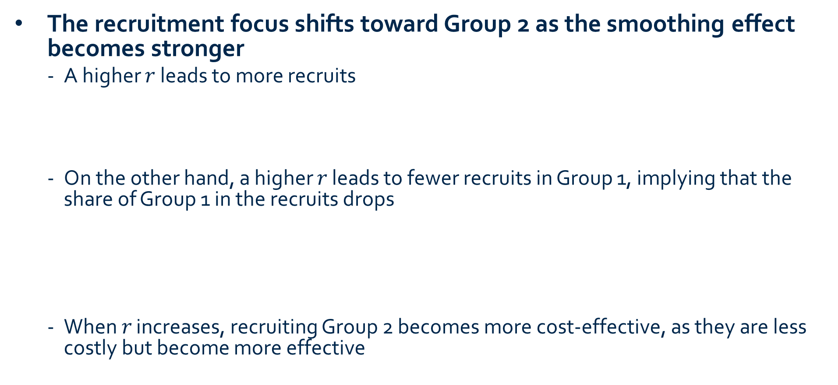

Managerial Insights – Hiring Strategy
The recruitment focus shifts toward Group 2 as the smoothing effect becomes stronger
A higher $r$ leads to more recruits
On the other hand, a higher 𝑟 leads to fewer recruits in Group 1, implying that the share of Group 1 in the recruits drops
When 𝑟 increases, recruiting Group 2 becomes more cost-effective, as they are less costly but become more effective
$$B=\frac{\left(r\left(1−\frac{s_{m}κ}{δN}\right)−1\right)θδN}{ρrDs_{m}}−θ\frac{d}{D−d}$$
$$A=\frac{θδN−\left(1−ρ\right)rs_{m}θ\frac{Dd}{D−d}}{θδN+\left(1−ρ\right)rDs_{m}}$$

Slide 25
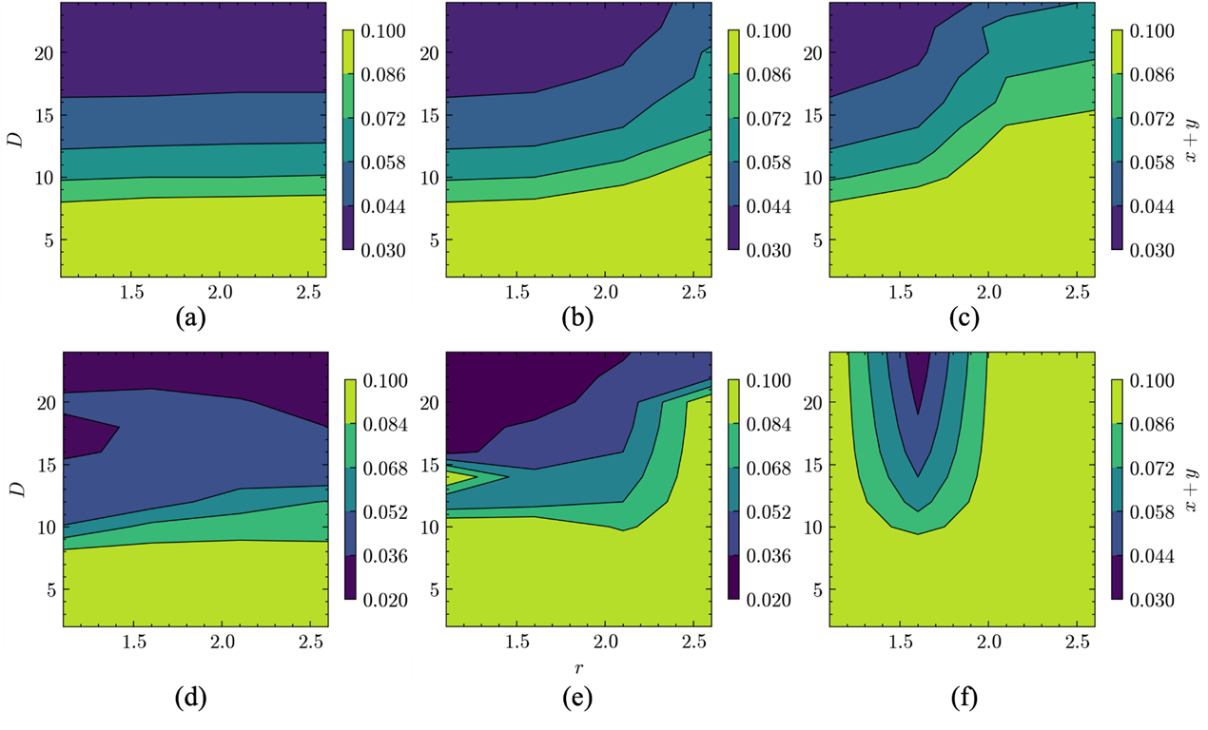
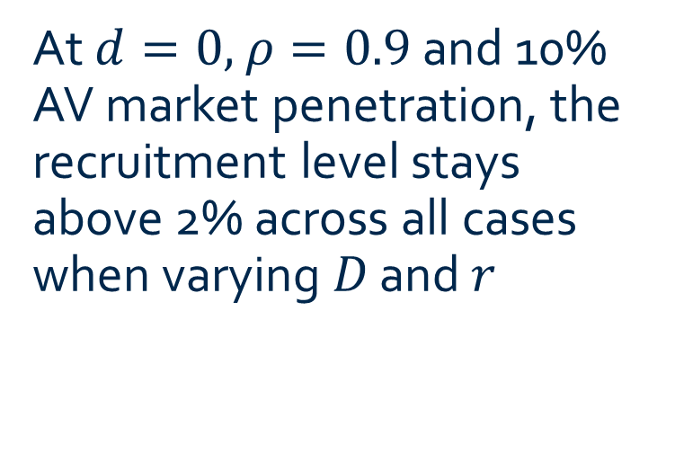
Numerical Validation
Scenarios |  | Smoothing effect
 |  | Marginal increasing | Linear | Marginal decreasing
Cost of agency | Uniform | (a) | (b) | (c)
 | Truncated normal | (d) | (e) | (f)
At $d=0,$ $ρ=0.9$ and 10% AV market penetration, the recruitment level stays above 2% across all cases when varying 𝐷 and 𝑟

Slide 26
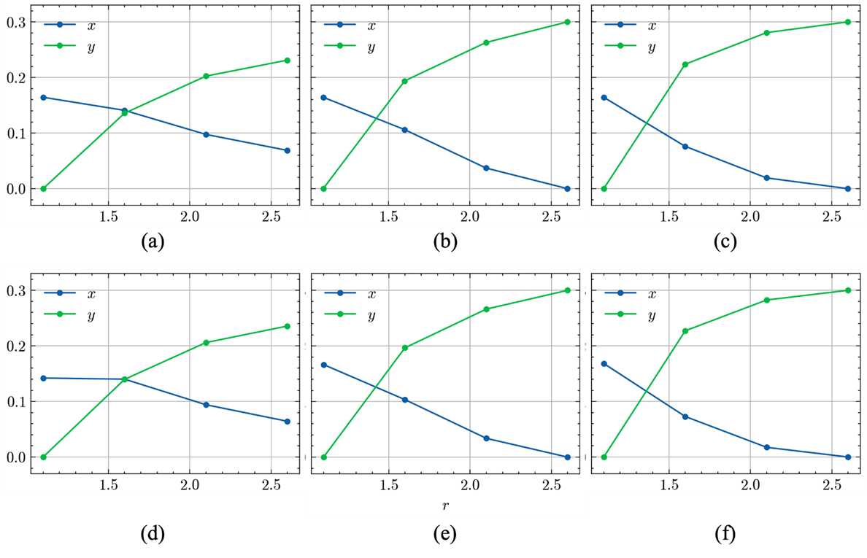
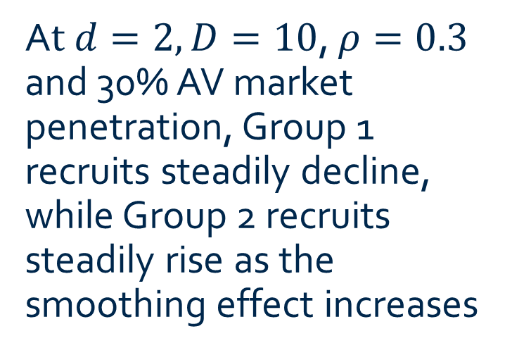
Numerical Validation (Cont’d)
Scenarios |  | Smoothing effect
 |  | Marginal increasing | Linear | Marginal decreasing
Cost of agency | Uniform | (a) | (b) | (c)
 | Truncated normal | (d) | (e) | (f)
A$t d=2, D=10$, $ρ=0.3$ and 30% AV market penetration, Group 1 recruits steadily decline, while Group 2 recruits steadily rise as the smoothing effect increases

Slide 27
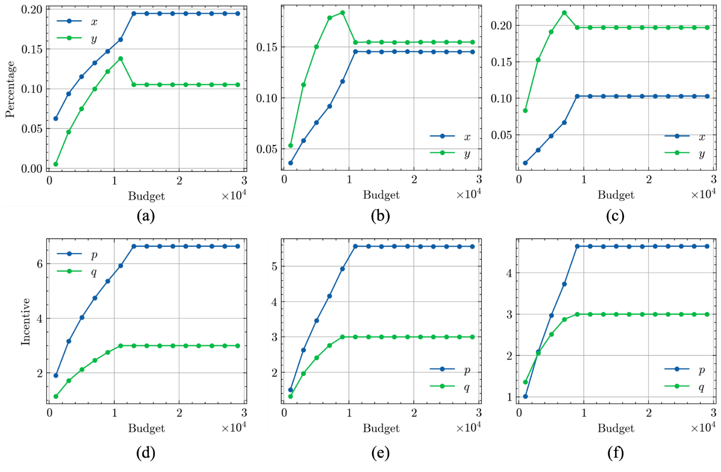
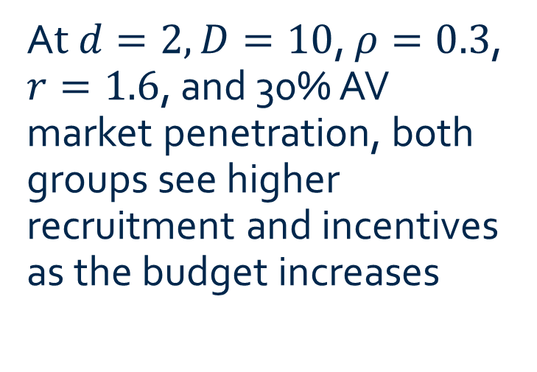
Second-Best Solution
Scenarios |  | Smoothing effect
 |  | Marginal increasing | Linear | Marginal decreasing
Cost of agency | Uniform | (a) | (b) | (c)
 | Truncated normal | (d) | (e) | (f)
A$t d=2, D=10$, $ρ=0.3$, $r=1.6$, and 30% AV market penetration, both groups see higher recruitment and incentives as the budget increases

Slide 28
Controlling CAVs for Network Efficiency

Slide 29
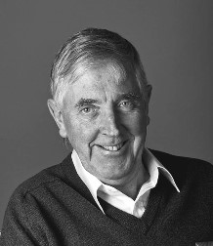
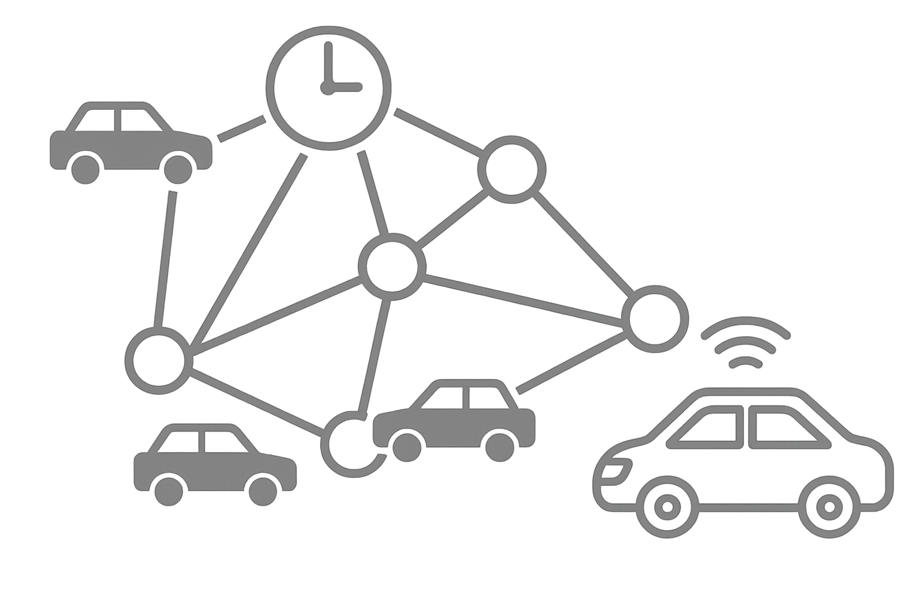
Problem Setting
We consider a general network where the routes or/and departure times of a fraction of CAVs can be controlled to reduce cumulative system travel cost over time.
Uncontrolled vehicles (UVs) behave selfishly, adjusting their choices day-to-day following a certain dynamics like the one proposed by Smith (1984), though this process is not necessarily known to the traffic authority.
We thus aim for a model-free, distributed control policy that lets CAVs act based on local information.
Mike Smith
(2007 INFORMS
Robert Herman Lifetime Achievement Awardee)

Slide 30
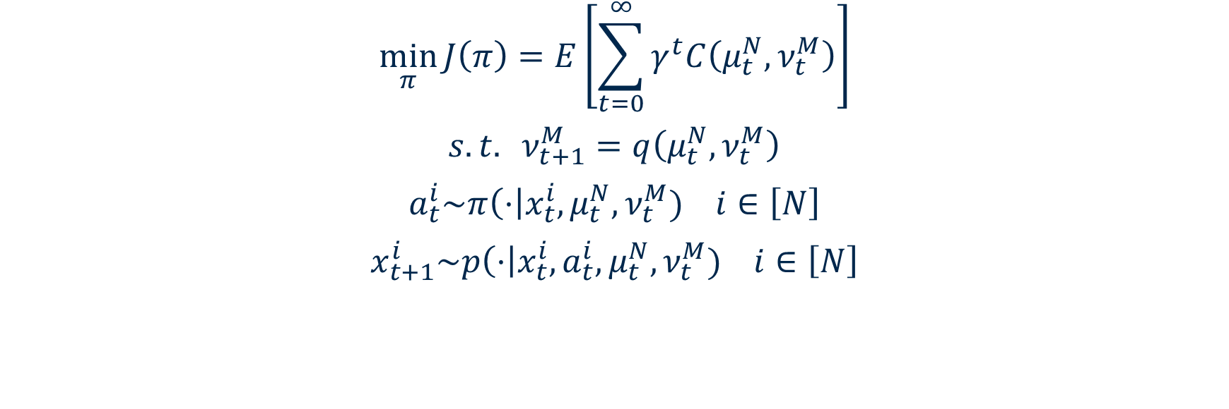

Finite-Agent Optimal Control Problem
Total discounted cost over time
$$\min_{π}{J\left(π\right)=E\left[\sum_{t=0}^{∞}{γ^{t}C\left(μ_{t}^{N}, ν_{t}^{M}\right)}\right]}$$
$$s.t. ν_{t+1}^{M}=q\left(μ_{t}^{N},ν_{t}^{M}\right)$$
$$a_{t}^{i}\sim π\left(⋅\right|x_{t}^{i},μ_{t}^{N},ν_{t}^{M}) i∈\left[N\right]$$
$$x_{t+1}^{i}\sim p\left(⋅\right|x_{t}^{i},a_{t}^{i},μ_{t}^{N},ν_{t}^{M}) i∈\left[N\right]$$
Transition kernel for uncontrolled vehicles
Sample action from CAV routing policy
Transition kernel for CAVs
If the transition kernels $p$ and $q$, as well as the system cost $C$ are Lipschitz continuous w.r.t $μ$ and $ν$, there always exists an optimal policy
Proposition
Finding such a policy becomes intractable as the number of agents grows large*
*Yang, Y., R. Luo, M. Li, M. Zhou, W. Zhang, and J. Wang (2018) Mean field multi-agent reinforcement learning. Proceedings of the 35th International Conference on Machine Learning, PMLR 80:5571-5580.
Notes:
human driver’s response
Assign travel choice for each CAV
Each CAV’s response to the assignment

Slide 31




Mean-Field Approximation
Let $N,M→∞$
Uncontrolled vehicles (UV) (modeled by a Markov process)
State: the empirical distribution $ν_{t}^{N}→ν_{t}∈𝒫(𝒳)$, a mean-field travel choice distribution under the law of large numbers
Transition $ν_{t+1}\sim q\left(⋅|ν_{t},μ_{t}^{}\right)$
CAVs (modeled by a Markov decision process)
State $x_{t}∈𝒳$ (current travel choice), a realization of a random variable whose distribution matches the MF distribution $μ_{t}$
Action $a_{t}∈𝒳$ (choosing next travel choice) sample from policy $π\left(⋅|x_{t}, μ_{t},ν_{t}\right)$
Transition $x_{t+1}\sim p\left(⋅|x_{t},a_{t},μ_{t},ν_{t}\right)$
$\left(μ_{t},ν_{t}\right)$ as the state (population state) population cost $c\left(μ_{t},ν_{t}\right)$ (system travel cost)
Let $π_{t}\left(μ_{t},v_{t}\right)=π_{t}\left(⋅|⋅,μ_{t},ν_{t}\right)$, and represent the state-action joint distribution across the CAVs as the population action $h_{t}=μ_{t}⊗π_{t}\left(μ_{t},v_{t}\right)$ (CAV assignments)
The action is sampled from a new policy $h_{t}\sim \hat{π}\left(μ_{t},ν_{t}\right)$
Transition $μ_{t+1}=T\left(ν_{t},μ_{t},h_{t}\right),ν_{t+1}\sim q\left(ν_{t},h_{t} \right)$ (population response)
where $T\left(ν_{t},μ_{t},μ_{t}\right)=\sum_{x}{\left[\sum_{a}{p\left(⋅\right|x,a,μ_{t},ν_{t}) π_{t}\left(a | x,μ_{t},ν_{t}\right)μ_{t}\left(x\right)}\right]}$

Slide 32
Mean-Field Approximation
 | Finite Agent Control | Mean-Field Control
State | Current route choice of each CAV Route choice distribution of UVs | Current route choice distributions of two groups (representative agents)
Action | Assigned route choice of each CAV | Joint distribution of current and assigned route choices for all CAVs (population action)
Transition | Each CAV follows assignment UVs follow day-to-day dynamics | CAVs follow a population kernel UVs follow day-to-day dynamics
Cost | Total cost of all vehicles | Total cost of all vehicles

Slide 33


Single-Agent Mean-Field Control
$$\min_{\hat{π}}{J\left(\hat{π}\right)=E\left[\sum_{t=0}^{∞}{γ^{t}c\left(μ_{t}, ν_{t}\right)}\right]}$$
$$s.t. ν_{t+1}=q\left(μ_{t},ν_{t}\right)$$
$$h_{t}\sim \hat{π}\left(⋅\right|μ_{t},ν_{t})$$
$$μ_{t+1}\sim T\left(⋅\right|μ_{t},ν_{t},h_{t})$$
Transition kernel for uncontrolled vehicles
Sample action from the population policy
Transition kernel for CAVs
If the transition kernels $p$ and $q$, as well as the system cost $c$ are Lipschitz continuous w.r.t $μ$ and $ν$, there always exists an optimal policy for MFC
Proposition*
*Cui, K., C. Fabian, Tahir, A., and H. Koeppl (2024) Major-Minor Mean Field Multi-Agent Reinforcement Learning, Proceedings of the 41st International Conference on Machine Learning, PMLR 235:9603-9632.

Slide 34

RL-Based Distributed Policy *
Input: Initialize population policy ${\hat{π}}^{ω}$
for iterations $t=1,2,…$ do
 | Sample population action $h_{t}\sim {\hat{π}}^{ω}\left(⋅ | μ_{t},ν_{t}\right)$ Broadcast $h_{t}$
 | for CAV agent $i=1,2,…,N$ do
 |  | Retrieve individual policy $π_{t}$ from $h_{t}$ Sample and execute action $a_{t}^{i}\sim π_{t}\left(⋅ | x_{t}^{i}\right)$
 | end for
 | Observe cost $C_{t}$, next population state $μ_{t+1},ν_{t+1}$
 | Update policy ${\hat{π}}^{ω}$ (with RL algorithms)
end for
*Wu, M., Wang, M., Yin, Y. and Lynch, J. (2024) Leveraging connected and automated vehicles for participatory traffic control. Transportation Research Part C, Vol. 166, 104757.

Slide 35

Numerical Experiments
Distributed departure-time policy with Vickrey’s bottleneck setting

Slide 36


Numerical Experiments (Cont’d)
Implementation of the resulting policy: 100% controllable, random initialization, average of three trials
Notes:
In the experiment, the departure rate on day 0 is randomly generated, and the rate on all following days is induced by the trained policy. I plotted the average curve of 20 experiments for the first three days, as well as the theoretical SO curv

Slide 37
Concluding Remarks

Slide 38
Key Takeaways
Advancements in connectivity and automation will make travelers more willing to give up personal control over their travel choices.
CAVs with relinquished agency can serve as “traffic demand distributors,” coordinating routes and departure times to enhance system performance.
Controlling ~15–20% of traffic can be effective, but required share varies by context.
Incentives help recruit CAVs by compensating drivers for their reduced control and any added travel costs.
Implementing such schemes is likely economically sensible for managing rush hour congestion in large cities.
Mean-field reinforcement learning effectively trains distributed control policies.
Participatory traffic control could be a promising addition to our congestion management toolbox.

Slide 39
Synergistic Integration with Other Instruments*
For example, participatory traffic control, when integrated with path-based pricing, can create synergies that offset each method’s weaknesses.
Network | Zones | Nodes | Links | MCR (%) | Zero –Revenue MCR (%)
Anaheim | 38 | 416 | 914 | 21 | 0.73
Barcelona | 110 | 1020 | 2522 | 36 | 0.32
Berlin-Mitte-Prenzlauer Berg-Friedrichshain-Center | 98 | 975 | 2184 | 14 | 0.06
Eastern-Massachusetts | 74 | 74 | 258 | 20 | 0.48
Sioux Falls | 24 | 24 | 76 | 14 | 0.70
Terrassa | 55 | 1609 | 3264 | 57 | 23
Winnipeg | 147 | 1052 | 2836 | 42 | 0.6
*Chen, Z., Lin, X, Yin, Y. and Li, M. (2020) Path controlling of automated vehicles for system optimum on transportation networks with heterogeneous traffic stream. Transportation Research Part C: Emerging Technologies, 110, 312-329.

Slide 40










Controlling CAVs to Stabilize System Dynamics*
Leveraging $δ$-dissipativity for stabilizing discrete-time mixed-traffic dynamic systems
Dissipation Inequality
$$S\left(x_{k+1},p_{k}\right)≤σ\left(x_{k+1},p_{k}\right)+s(δx_{k},δp_{k})$$
Evolutionary Dynamics (EDM)
Flows
Propose novel backward EDM $ν\left(x_{k+1},p_{k}\right)$
Prove EDM dissipativity by finding $S\left(x_{k+1},p_{k}\right)$, $s(δx_{k},δp_{k})$
Time
CAV Control
Payoff
$$δp_{k}$$
Flows
$$δx_{k}$$
Payoff Dynamics (PDM)
Payoff Dynamics (PDM)
Design controller / payoff mechanism $δp_{k}$to enforce $s\left(δx_{k},δp_{k}\right)≤0$
Flows
Time
* Lee, R., Scruggs, J., and Yin, Y. (2025) Discrete-Time Stabilization of Nash Equilibrium for Mixed Traffic Routing. 2025 American Control Conference, July 8-10, 2025, Denver, CO, USA

Slide 41
Evolution of Traffic Control
Reservation-based control for fully-organized systems
Participatory control for semi-organized systems
Level of AV Market Penetration
Traditional traffic control for self-organizing systems
Level of Relinquished Travel Agency

Slide 42
Email: yafeng@umich.edu
Thank You
Yafeng Yin, Ph.D.
Donald Cleveland Collegiate Professor of Engineering
Donald Malloure Department Chair of Civil and Environmental Engineering
University of Michigan, Ann Arbor

Slide 43


Numerical Experiments (Cont’d)
Distributed routing policy:
Sioux Falls Network
Notes:
The total travel cost in an episode (200 days)
Every episode is randomly initialized:
Penetration rate =0; Randomness due to initialization, Normalize its average to 1,
The lower bound is that the system directly arrives at and maintain SO since the second day

